Slide 1
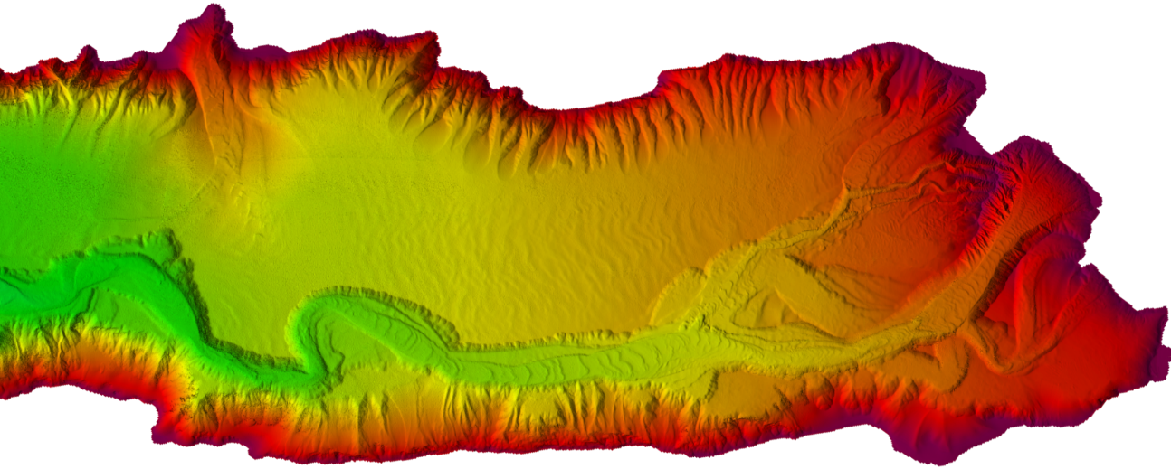
S102: Enabling Automated Cartography Proposal for Discussion
Anthony Klemm
16 February 2021
Notes:
The seamless, S-102 bathymetric surface resulting from the NBS project enables creation of nautical charts while also providing a foundational product that supports modeling, exploration, industry, science, regulation, and public curiosity.

Slide 2
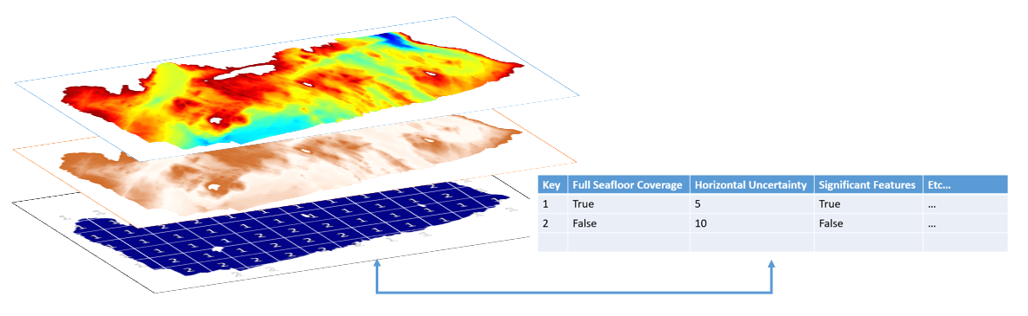
S102 Vision
Provide the information to support automated cartography reflecting the depth, quality of the depth, and source of the depth.
The information to support the automated cartography and traditional cartography are the same.
S-102 is intended (initially) to support low under keel clearance systems, but is viewed as the future of chart products.
Bathymetry
Uncertainty
Quality / Source

Slide 3
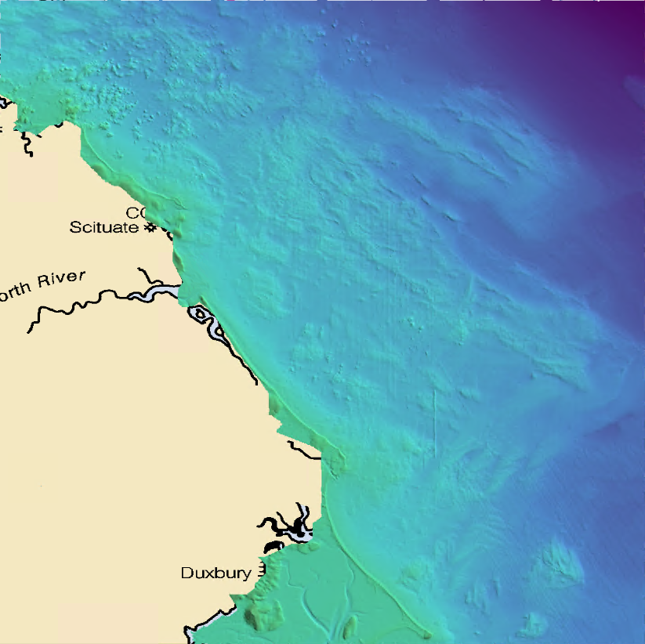
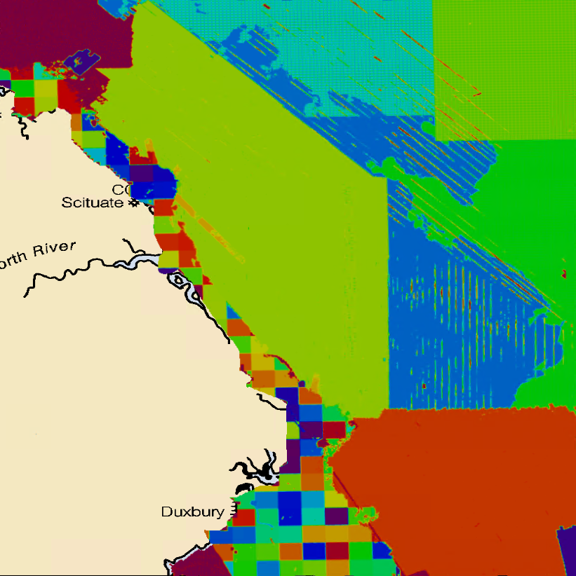
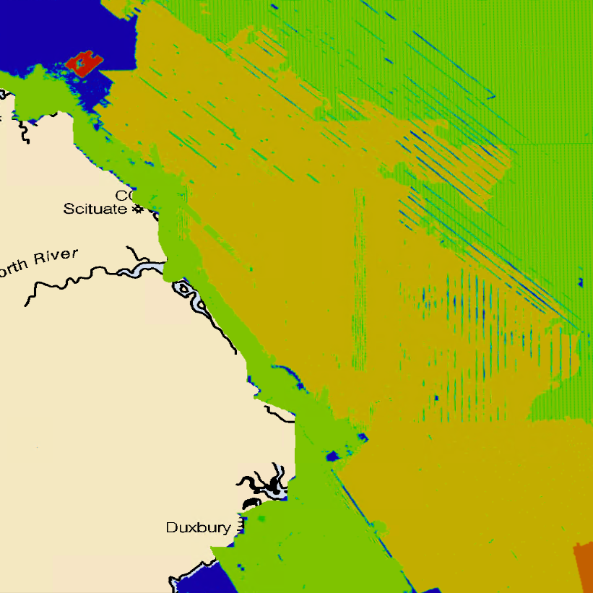
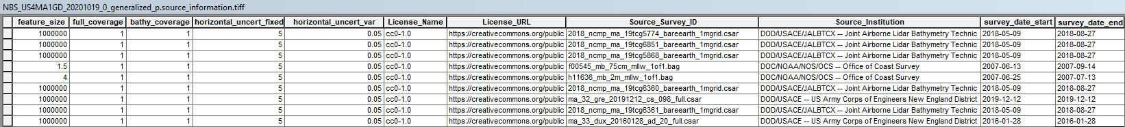
Source and Quality as a Layer
Bathymetry
Source
Quality

Slide 4
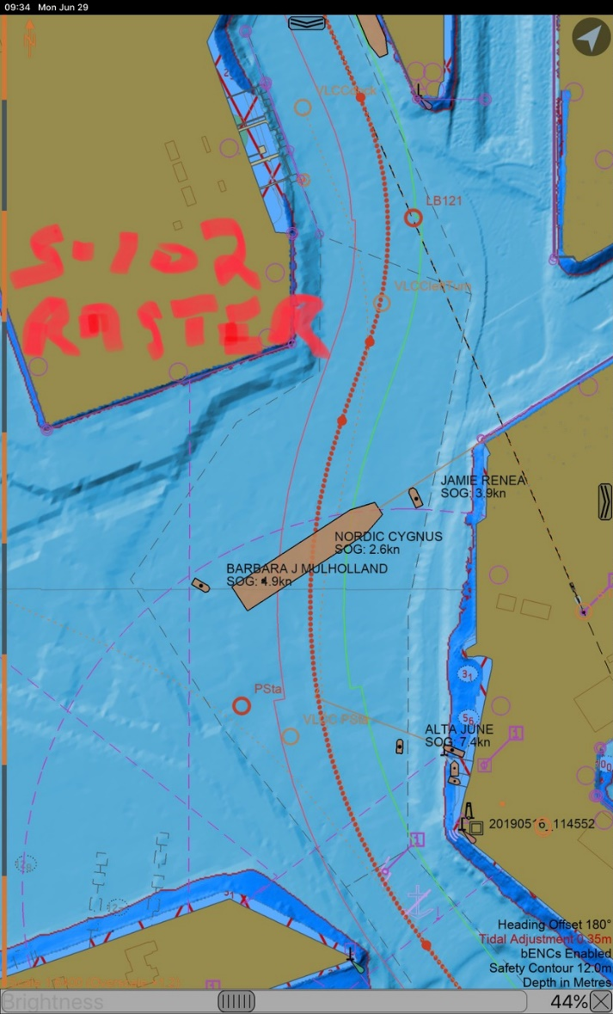
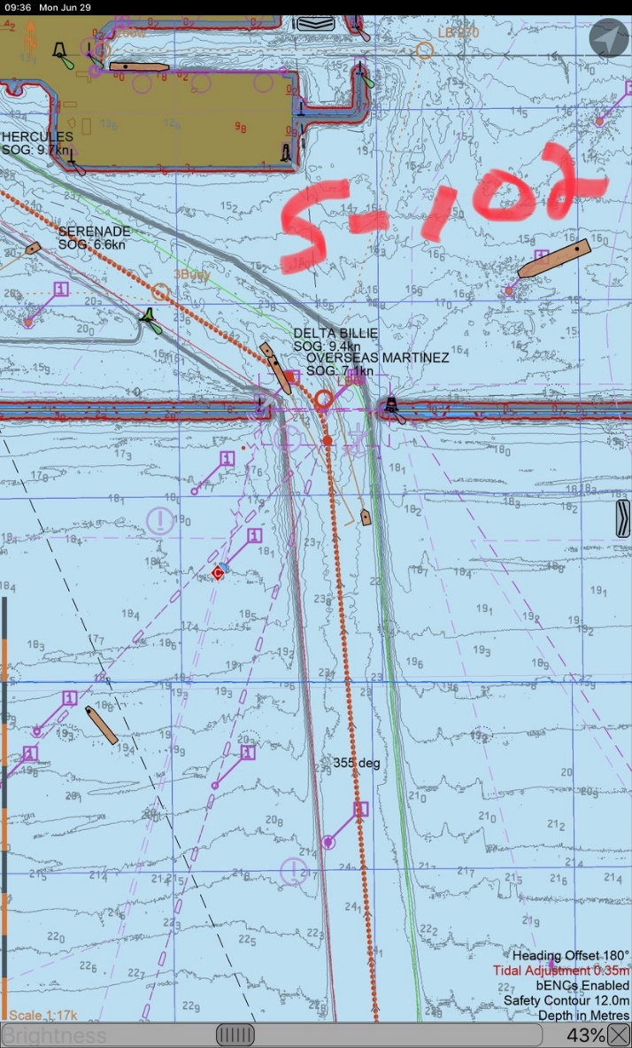
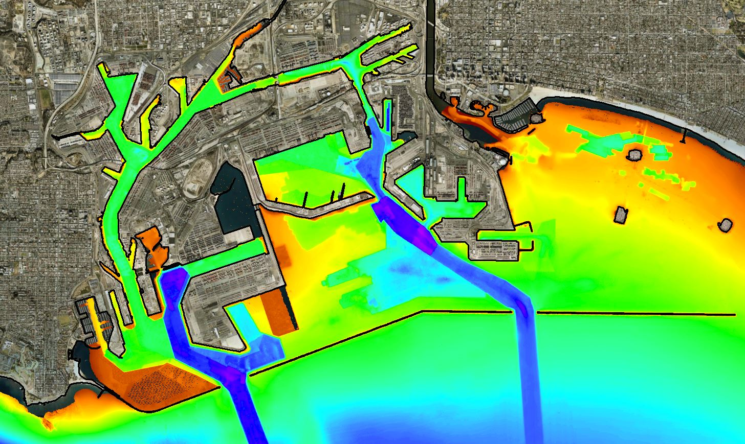
Use of S102 for precision navigation
Port of LA Long Beach, CA

Slide 5
For Project Team Discussion
Metadata needed to flag interpolated nodes
Why: Prevents sounding selection and display from interpolated data, and forces software to display soundings from actual bathymetric observations, while still enabling generalized contour creation.
Uncertainty (i.e. Quality Metadata Fields) – Keep within S102 Navigation Dataset
Why: Enables the calculation of real-time underkeel clearance for portrayal in PPUs (more important for the navigation system manufacturer than for the mariner)
Portrayal of quality in automated cartography (soundings, contours): Need to coordinate with DQWG

Slide 6
For Project Team Discussion
Source Information – Add to S102 Navigation Dataset
Why: Enables automated creation of nautical cartography (depth areas, contours, soundings, i.e. SORIND/SORDAT) with mandatory S101 Attribution
File size and tiling considerations
Is there a need to overarching guidance for tiling or is it completely up to each HO?
Dealing with elevation data (i.e. topobathy lidar) that is above sounding and shoreline datums

Slide 7
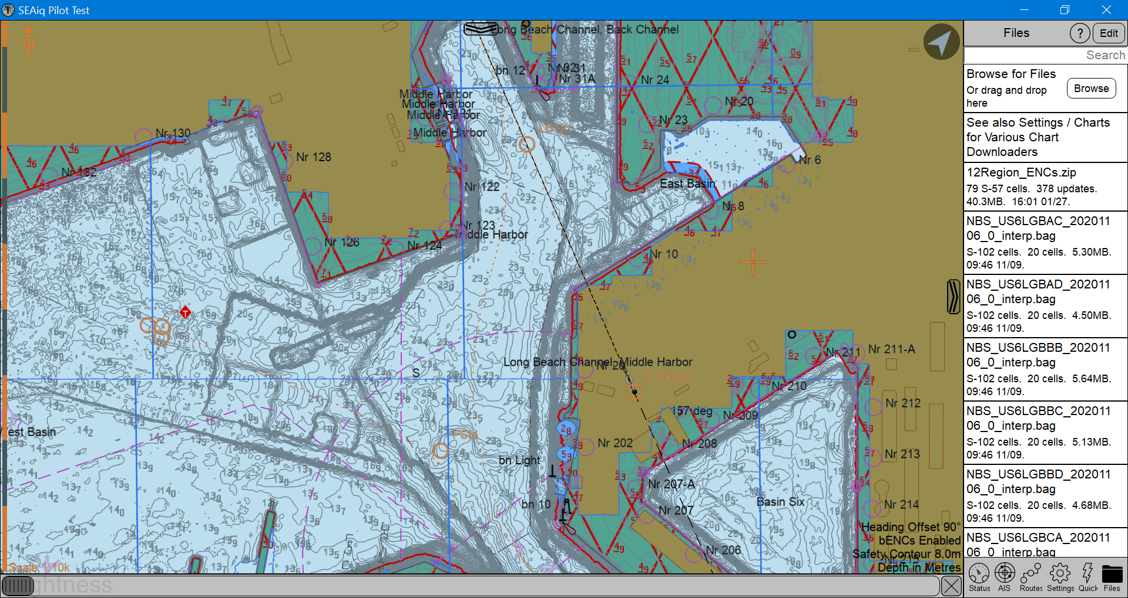
Use of S102 with elevation data above sounding and shoreline datums

Slide 8
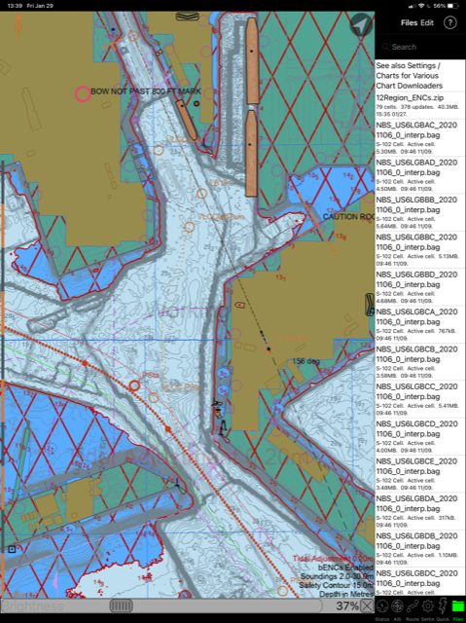
Use of S102 with elevation data above sounding and shoreline datums

Slide 9
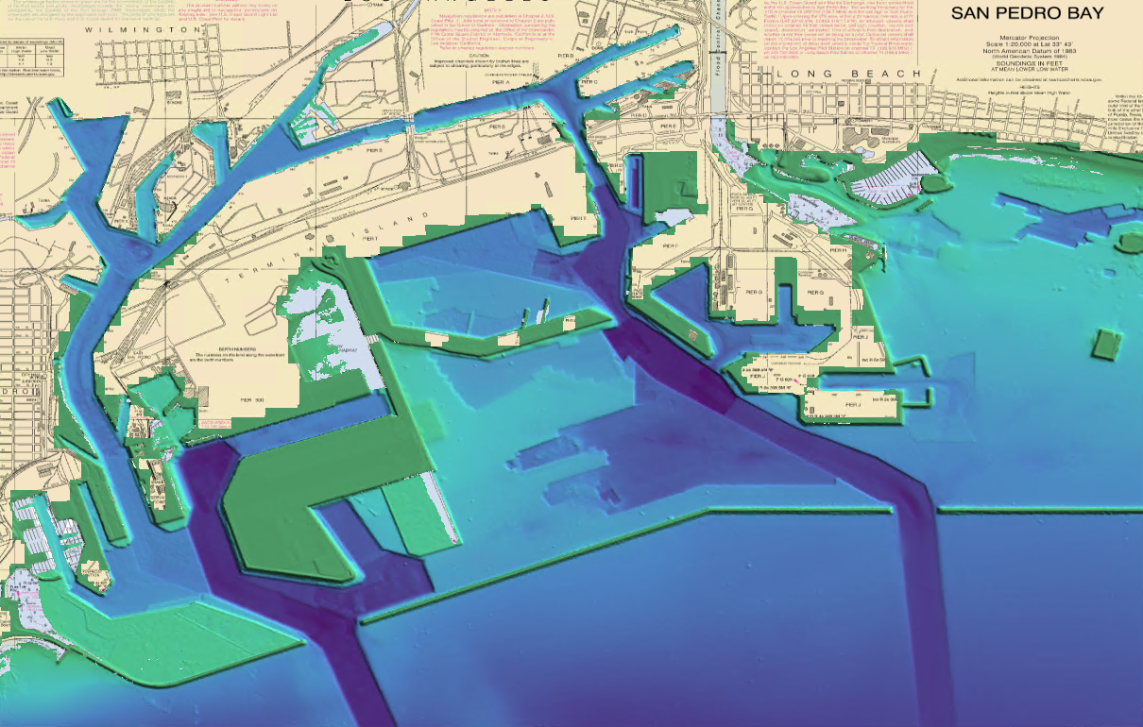
Use of S102 with elevation data above sounding and shoreline datums

Slide 10
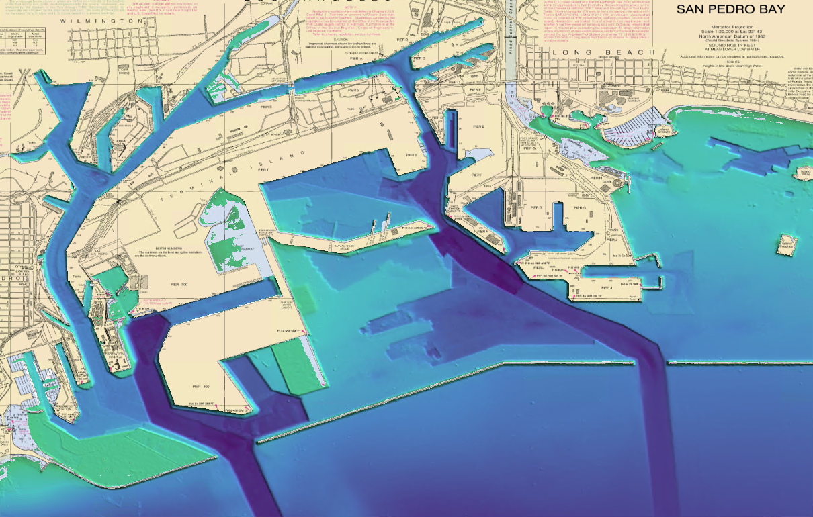
Use of S102 with elevation data above sounding and shoreline datums

